Slide 1
Showroom3D_Web(React)
Archana
8 August,2024

Slide 2
Requirements
State management
Modularization

Slide 3
State management use cases
Light controls in the scene to reflect on the UI and vice versa
Update animations,material variants values based on the object added / selected
Modes (arrangement,measurements,camera,collaboration)
Update light control values based on Day/Night toggle
Add objects to Physics world when new object added into the scene

Slide 4
State management

Slide 5
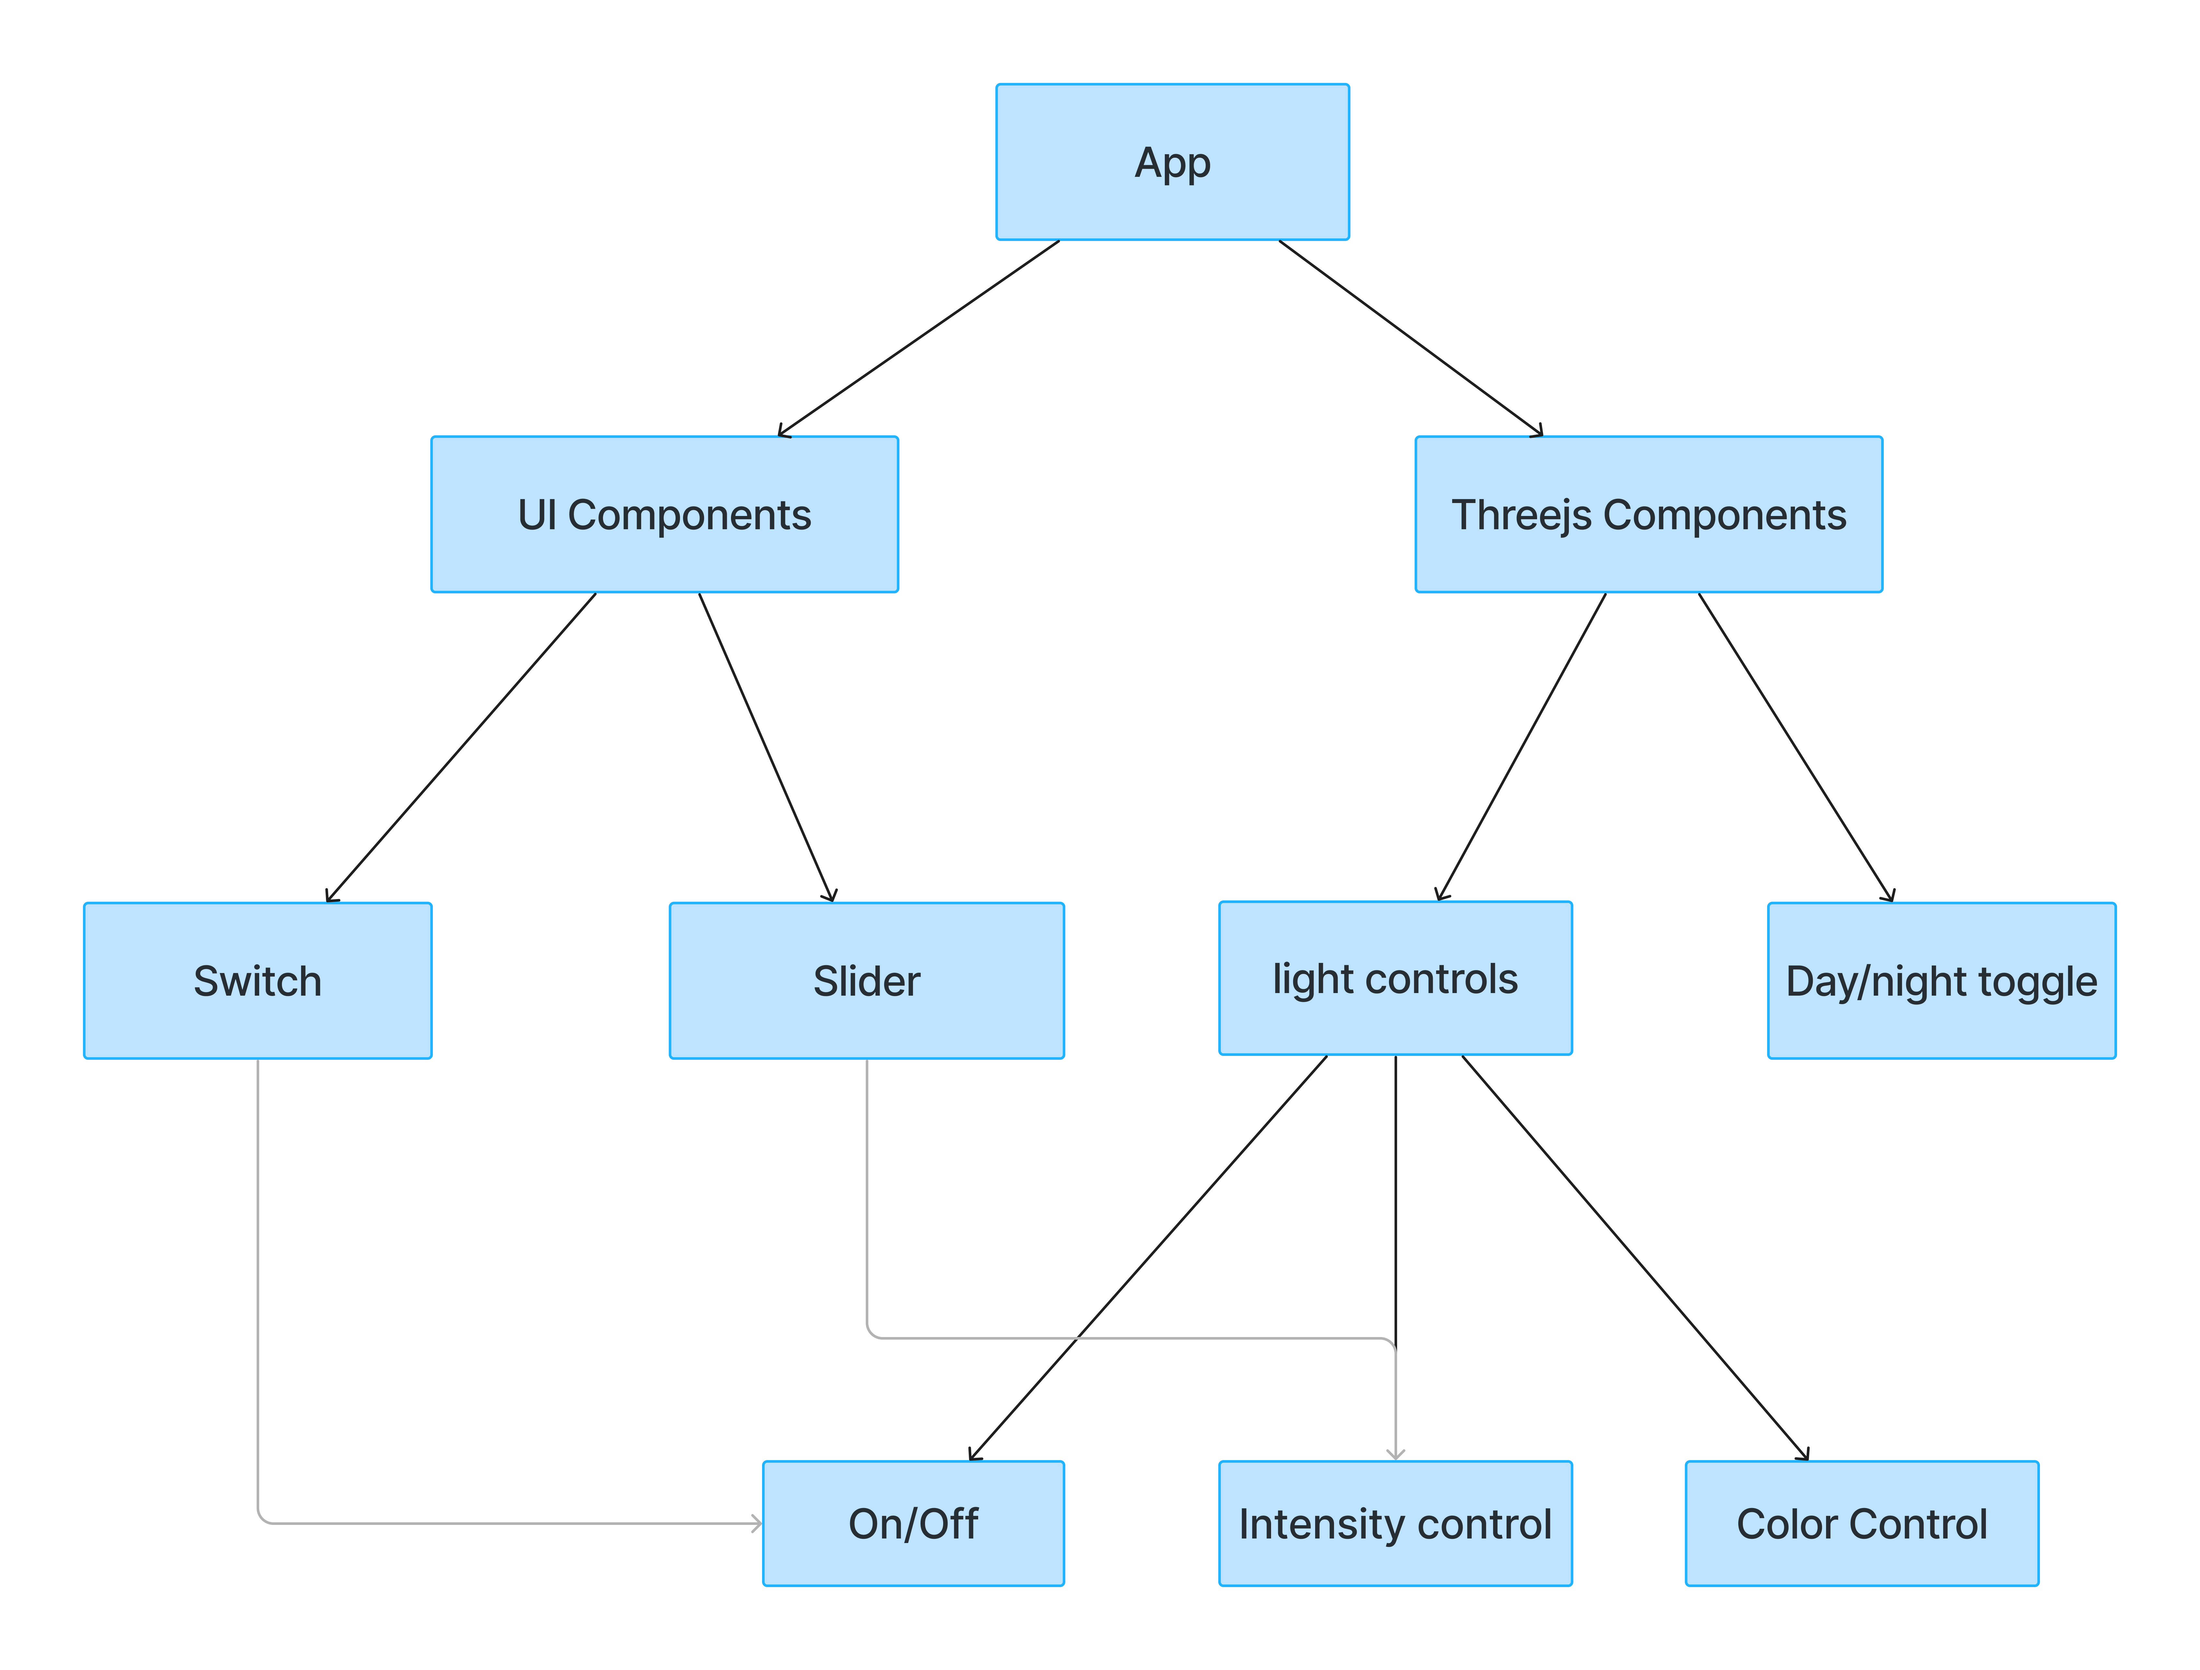
Modularization

Slide 6
Modularization

Slide 7
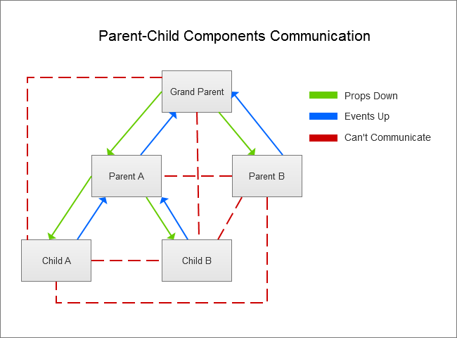
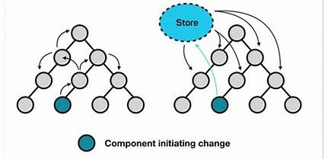
Parent child relation in react

Slide 8
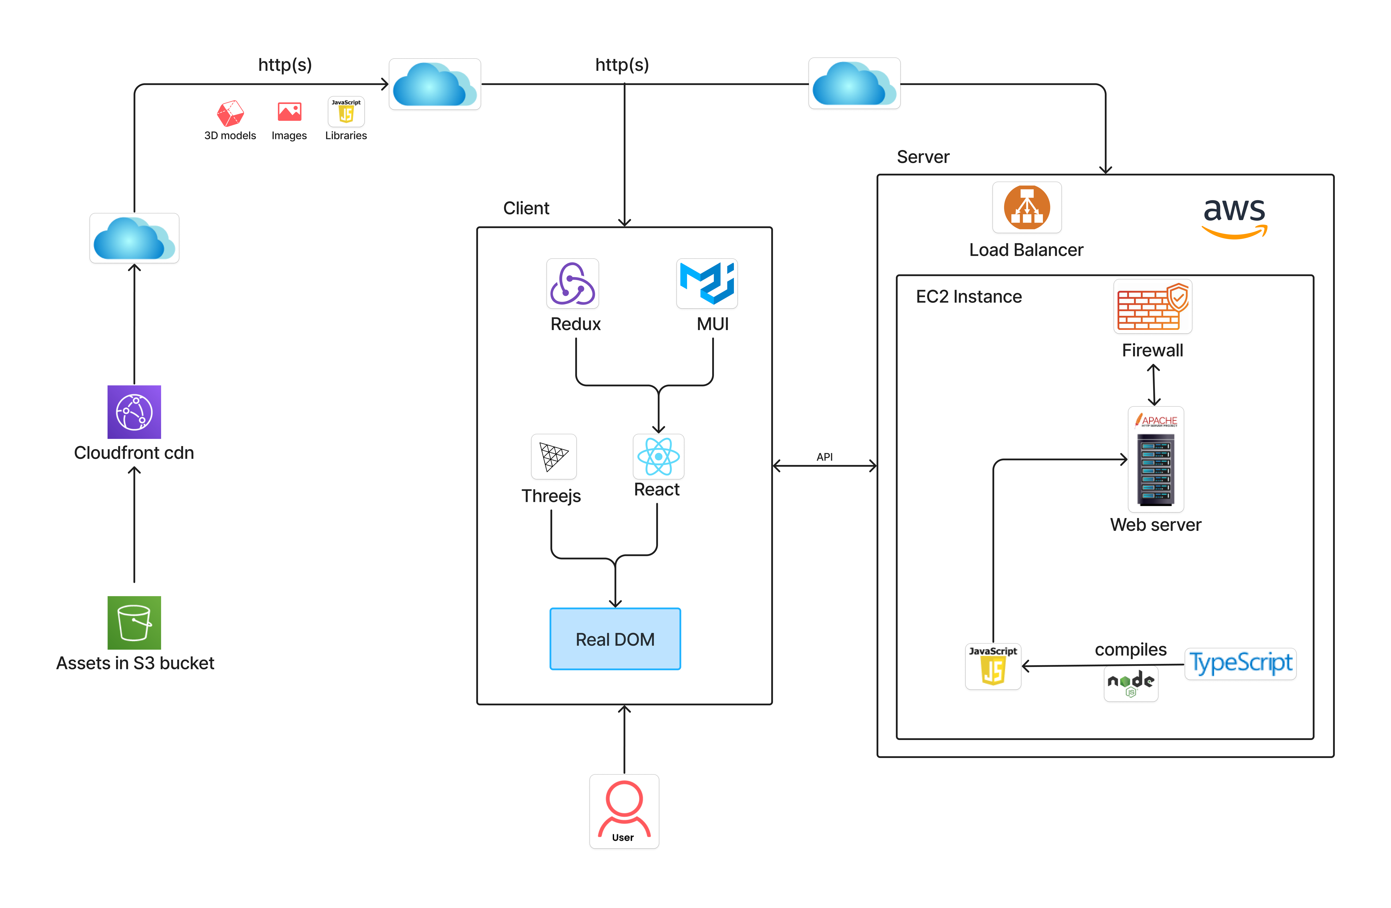
Architecture diagram

Slide 9
Add furniture objects

Slide 10
Process to move the Showroom3D demo to React framework
Create UI by using MUI components.
Load basic threejs scene
Enable camera controls,viewpoints and themes
Setup postprocessing effects
Load different furniture types and its related dynamics,variants and etc by maintaining state to reflect accurately on the UI
Load different light types and show related light controls by maintaining state to reflect accurately on the UI
Implement arrangement features
Implement measurements features
Implement HD Render feature

Slide 11
Major Technologies
Threejs
Typescript
React
Redux
MUI

Slide 12
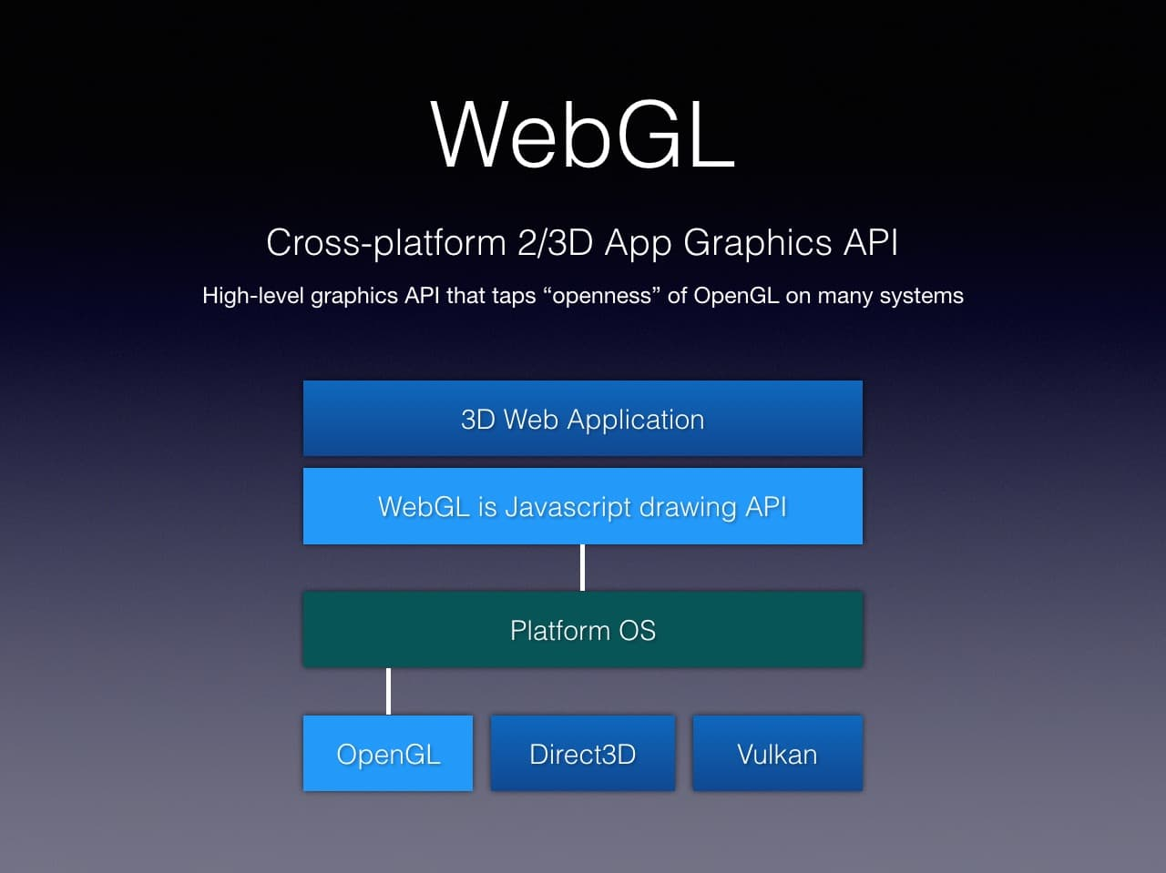
Threejs

Slide 13

TypeScript
Static Typing
JavaScript Compatibility
Improved Code Readability

Slide 14
React
Modular and Reusable
By breaking down the UI into smaller, manageable components, React promotes modularity and we can reuse these components across the app
Virtual DOM
When the state of an object changes, React updates the virtual DOM first, which then compares it with the real DOM and makes only the necessary updates. This results in faster and more efficient rendering.
JSX – JavaScript Syntax Extension
With jsx, we can write html code inside js file, so that we can write reusable UI components as well
Dynamic Content
We can dynamically update content of dynamics,material variants etc when we add object
Predictable State Management
By using redux or react context, values will be explicitly updated in the state
Scalability
The ability to break down the UI into reusable components and manage state efficiently helps in scaling applications as they grow

Slide 15
React Hooks
Hooks allow function components to have access to state and other React features.
Hooks allow us to "hook" into React features such as state and lifecycle methods.
UseState
This allows us to track state in a function component.
UseEffect
The useEffect Hook allows you to perform side effects in components.
Some examples of side effects are: fetching data, directly updating the DOM, and timers.
To update light values based on Day/night toggle state value we can use UseEffect hook
UseRef
The useRef Hook allows you to persist values between renders.
It can be used to store a mutable value that does not cause a re-render when updated.
It can be used to access a DOM element directly.

Slide 16
React Hooks cont.
UseContext
React Context is a way to manage state globally.
It can be used together with the useState Hook to share state between deeply nested components more easily than with useState alone.
We can store the scene and renderer values using the useContext hook, allowing us to access them throughout the application
we can update day/night toggle state value
Drawbacks:
When the context value changes, all components consuming that context will re-render, potentially leading to performance issues if the context is used widely in the application.
Doesn't natively support middleware for tasks like logging, handling side effects, or performing asynchronous operations.
Difficult to Debug

Slide 17
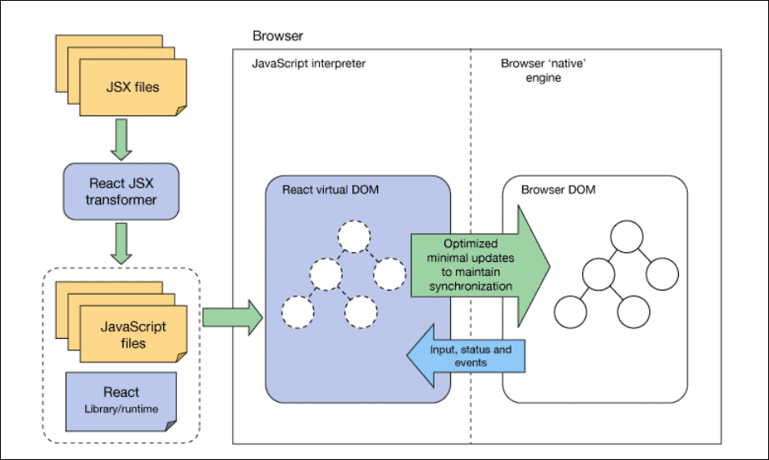
React Architecture

Slide 18
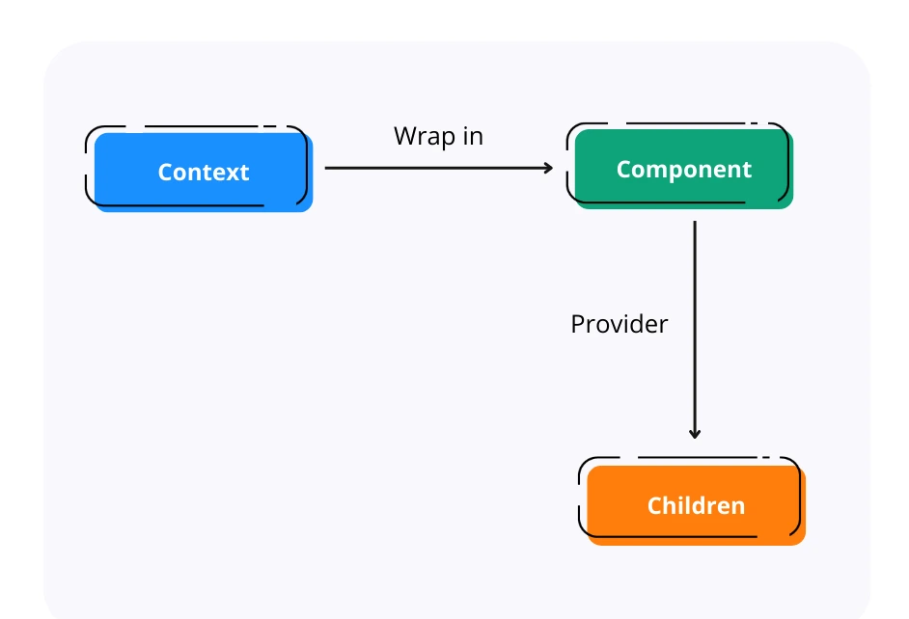
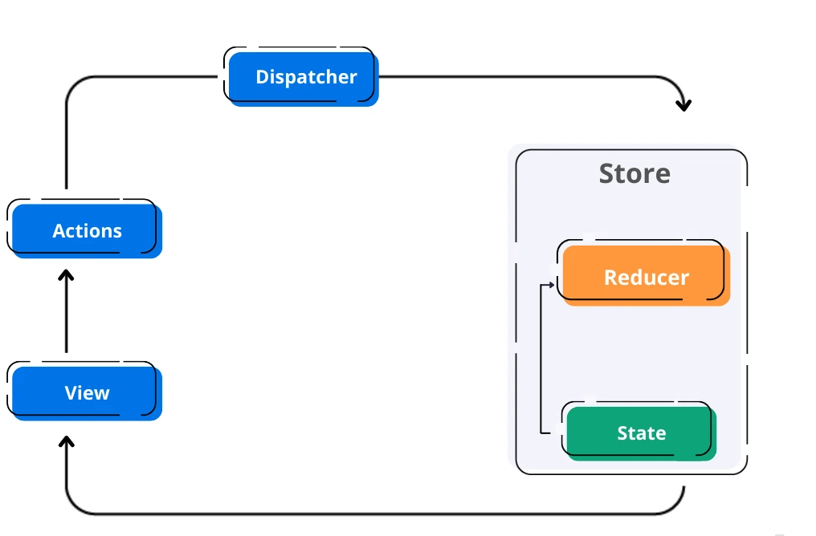
React Context vs Redux
React Context
Redux
Ease of Use

Slide 19
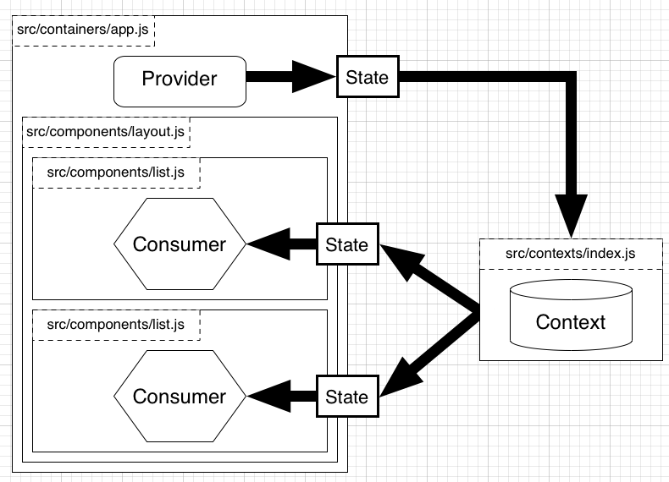
React Context
Ease of Use
Improved Performance
Global State Management

Slide 20
Redux
Centralized state management for better organization and predictability.
Improved Maintainability
Time travel debugging for easier development and troubleshooting
Immutable state for better performance and data integrity.
https://redux.js.org/tutorials/fundamentals/part-1-overview

Slide 21
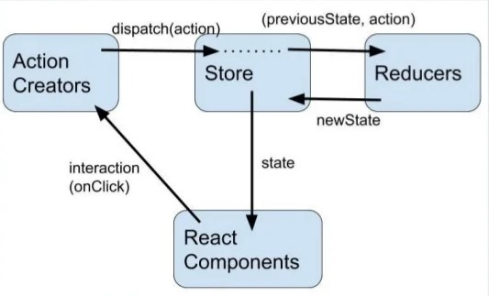
Redux

Slide 22
Context API Vs Redux
Context API | Redux
Requires minimal Setup | Requires extensive setup to integrate it with a React Application
Specifically designed for static data, that is not often refreshed or updated | Works like a charm with both static and dynamic data
Adding new contexts requires creation from scratch | Easily extendible due to the ease of adding new data/actions after the initial setup
Debugging can be hard in highly nested React Component Structure even with Dev Tool | Incredibly powerful Redux Dev Tools to ease debugging
UI logic and State Management Logic are in the same component | Better code organization with separate UI logic and State Management Logic

Slide 23
MUI
Adheres to Google Material Design
Pre-built Components
Performance
Accessibility
Responsive Design
Customization and Theming
Drawbacks:
Some components, such as carousel and color picker, are not available in MUI
Bundle Size

Slide 24
Bootstrap Vs MUI
Bootstrap | MUI
Unnecessary JS, jQuery scripts, and large class definitions might make that application heavy | It works on React JS components,doesn’t require any library to work
comparatively less customizable than Material UI. | Material UI is highly customizable
High speed of development because of reusable code | Speed of development is lesser than compared to bootstrap but can be increased by extensive use of reusable components and templates.

